Slide 1
Code Lists
Maintained by SMDG
SMDG Meeting Antwerp, 7.-8.10.2014

Slide 2
Code Lists By SMDG
More flexibility - introducing new codes within
short time
Independent on CEFACT directory
- No need to change directories or the message
structures
General guidelines for code list maintenance
Cover all SMDG MIG’s

Slide 3
Code Lists By SMDG
Handling Codes (introduced with BAPLIE 3.0)
Blocking Codes (introduced with BAPLIE 3.0)
ATT Codes (introduced with BAPLIE 3.0)
Delay Codes (proposal for IFTSAI and TPFREP)
Master Liner Codes
Terminal Facility Codes

Slide 4
SMDG Code - Implementation
Validity is defined in the latest version
Implementation should be adapted regularly to the
latest version

Slide 5
SMDG Code Lists: Guidelines
Unique codes
No changes neither in code nor in meaning
Codes that are no longer precise enough are to be
removed and new codes to be introduced
Codes that have been phased out to be blocked for n
years

Slide 6
SMDG Code Lists - Layout
Show the latest version: v201410
Date of last change of a certain code
Valid from – date of introducing the code
Valid before – date of phasing out a code
History – date and reason of change

Slide 7
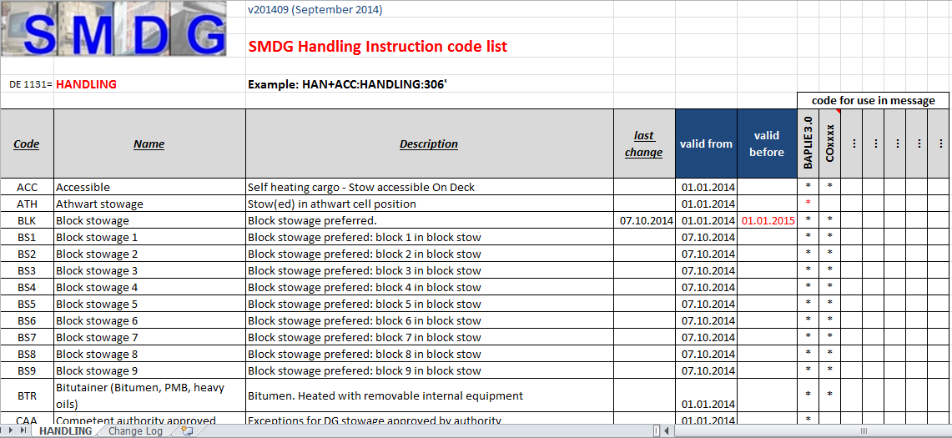
Handling Code List

Slide 8
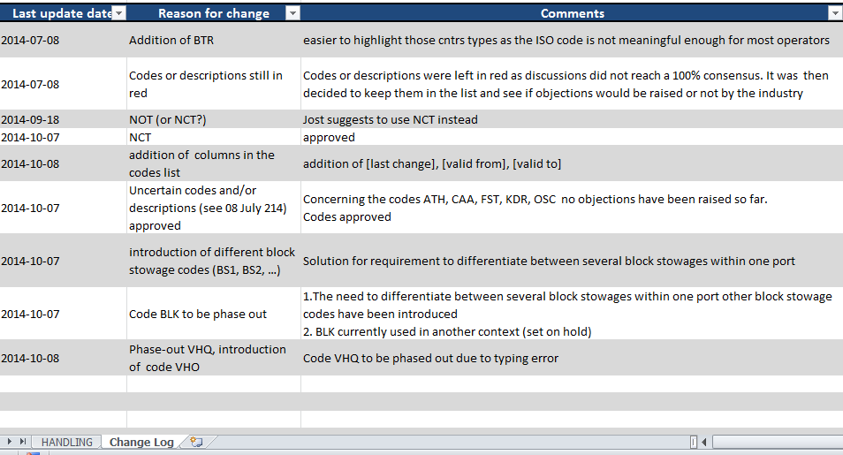
Handling Code List

Slide 9
Open items
Backward compatibility: how to deal with
different codes in the HAN list and current MIG
versions
→ postponed to discussion of container messages
Seperate list for handling instructions and for those
that are only stow location related

Slide 10
Other Code Lists By SMDG
Same design for:
Handling Codes (introduced with BAPLIE 3.0)
Blocking Codes (introduced with BAPLIE 3.0)
ATT Codes (introduced with BAPLIE 3.0)
Delay Codes (proposal for IFTSAI and TPFREP)
Master Liner Codes
Terminal Facility Codes

Slide 11
Thank you!

