Slide 1
Code Lists
SMDG Meeting Paris, 11.-13.04.2018

Slide 2
Codes Lists: Agenda
Overview Codes Lists
Terminal Facilities List / UN/LOCODEs
Handling Codes / Codes for special properties (grades)
Liner Codes List
BIC codes / Locodes (Depot Codes List)
Notes:
Those who do not attend these meetings regularly - introduction
Same basis for the discussion
Items : Terminal lcodes
Presentation HeideHandling codes
Liner codes
Project running: Harmonization of the depot codes list BIC/Codes: Patrick or Jorn

Slide 3
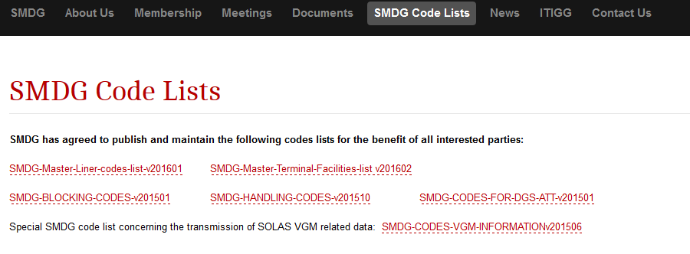
Agenda SMDG Code Lists
Notes:
International communication - unambiguous codes are absolutely necessary
Existence of some international codes lists
popular example: UNLOCODES for ports and other locations – run by UNECE
SMDG created code lists where international codes list were missing or not sufficient
To describe certain status, attributes or instructions in the EDIFACT messages

Slide 4
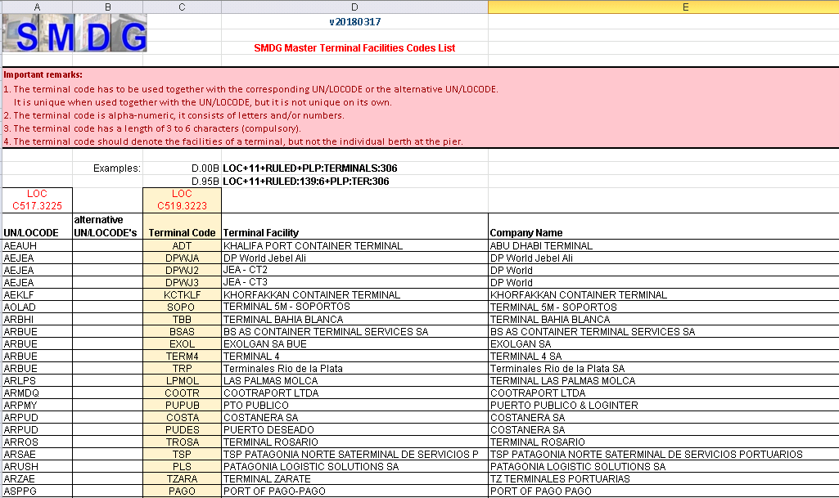
Agenda Terminal Facilities List

Slide 5
Agenda Terminal Facilities List
How to define a particular terminal by codes?
Unique by a combination of UN/LOCODE and Terminal Code
UN/LOCODE:
RULED
Terminal code:
PLP
LOC+11+
RULED
:TERMINALS:306
+PLP
Notes:
UN/LOCODE separated from the terminal code - advantages:
2 levels of identification: port or terminal – just as specific as required
flexibility → Adapt to changes in UN/LOCODE’s without loosing the uniqueness of the terminal identification
No influence on the UN/LOCODE List – not under SMDG responsibility but still it is integrated

Slide 6
Agenda UN/LOCODE’s
One terminal – different UN/LOCODE‘s
metropolitan UN/LOCODE versus municipal UN/LOCODE
UN/LOCODE’s for ports versus terminals
…
Notes:
Even if we only consider the codes with function “port” in the UN/LOCODE list there is more than one code applicable.

Slide 7
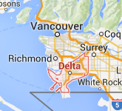
Agenda Terminal Facilities List
Measures:
alternative UN/LOCODE introduced
filled in on request

Slide 8
Agenda Special case: Chinese ports
Change of Chinese UNLOCODE’s:
Split up the codes for metropolitan areas (e.g. Shanghai - CNSHA) → 3 codes
airport, port and one for the metropolitan region
old UN/LOCODE’s are now assigned to the airports
For shipping industry:
metropolitan code - including port (e.g. CNSGH)
port (CNSHG)
Notes:
Excursus: Chinese ports
The Chinese decided to change their UN/LOCODE’s some years ago.

Slide 9
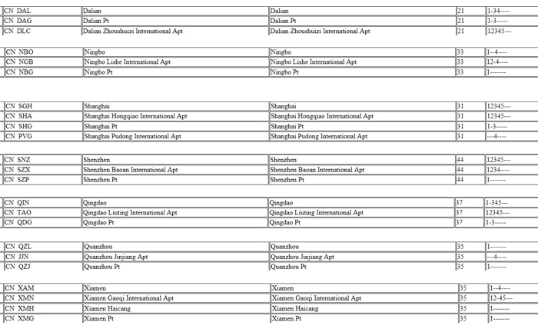
Agenda Chinese Un/LOCODES
Examples
Notes:
Since the SMDG terminal code list depends on the UN/LOCODE list we should adjust our codes accordingly.
Take into account that the SMDG has got a certain role and should offers some guidance to the user of our EDIFACT messages.
Today: majority of the shipping industry still uses the old codes, which means the airport codes
Some investigation results:
Shipping lines: Preference is on metropolitan code (CNSGH, CNNBO, …)
Currently old codes are still in use
Booking portals: ?
Forwarders: all options (old+new)
IMO: codes with function “ports” (CNSHG, CNNBG)
Portbase (port community system,Netherlands): codes with function ”port” (CNSHG, CNNBG)
DAKOSY (port communication system, Hamburg: new codes (CNSGH/CNSHG)
Chinese ports: seem to use the old codes (as per information of a major Chinese shipping line)
email to ports of Shanghai and Ningbo:…….. No answer yet

Slide 10
Agenda Guide lines
Guide lines
Terminal code length: 3-6 alphanumeric characters
Terminals of seaports
Codes for terminals – not berth within terminal quay
Specification of UN/LOCODE for a terminal:
?
Notes:
To do: Define a rule which UNLOCODE shall be the leading one

Slide 11
Agenda UN/LOCODE
Leading code (first column) and alternative code (second column)
Leading UN/LOCODE….options:
The UN/LOCODE the terminal itself prefers
The UN/LOCODE the party requesting a terminal code proposes
The most “common” UN/LOCODE
The metropolitan UN/LOCODE (high administration level)
The municipal UN/LOCODE (lower administration level)
Notes:
to find a rule for the leading code (first column) and the alternative code (second column) including consideration of the special case “China”
In the past:
Take the code the terminal itself prefers (if any reaction to my email…)
If not: The code the party requesting a terminal code proposes
Proposal: consider the administration level

Slide 12
Agenda UN/LOCODE
Leading code (first column) and alternative code (second column)
Leading UN/LOCODE….options:
The UN/LOCODE the terminal itself prefers
The UN/LOCODE the party requesting a terminal code proposes
The most “common” UN/LOCODE
The metropolitan UN/LOCODE (high administration level)
The municipal UN/LOCODE (lower administration level)
Notes:
Proposal for the „leading“ code:
→ Metropolitan code
In case of Chinese ports: codes that cover all functions, including function „port“
(CNSGH, CNNBO, … )

Slide 13
Codes Lists: Agenda
Overview Codes Lists
Terminal Facilities List / UN/LOCODE’s
Handling Code List / Codes for special properties (grades)
→ see presentation from Heidi Stemler

